Slide 1

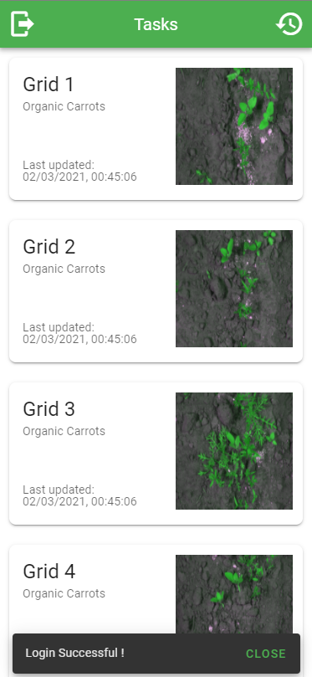
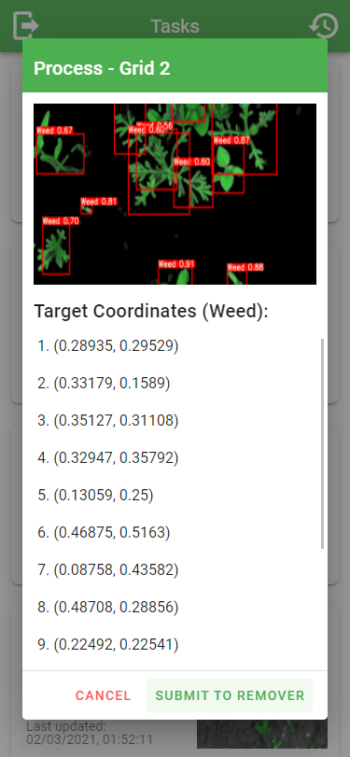

Precision Weed Management Using Computer Vision in
Modern Agriculture
Mr. Chen Tet Lun (TP045873)
BSc (Hons) in Computer Science
Supervisor: Mr. Dhason Padmakumar| Second Marker: Dr. Sivakumar
Introduction
The proposed weed management system proposes a machine vision approach on segmentation and classification of crop and weed with a complete frontend and backend implementation, ready to be implemented for different precision systems in the future. The exploitation of Normalized Difference Vegetation Index (NDVI), convolutional neural network (CNN) using YOLO via OpenCV has widely contributed to the project resulting in a detection accuracy at 92.94% and classification accuracy at 93.42%. A user-friendly web application interface paired with backend services powered by Vue.js and Flask has also been developed for further interactivity to increase the usefulness and maximize adaptability of the application for future implementation.
Aim
Deliverables
To propose a precision weed management system by integrating computer vision to replace the usage of herbicide and reduce labor, cost and time in weed removal.
Allow high differentiation rate of crops and weeds in different lighting or weather conditions while maintaining high speed operation.
Allow farmers to interface with the system in an intuitive environment.
Transmission of real-time footage from the camera to the user interface and return location of the weed detected in order to proceed to removal.
Exploit Convolutional Neural Networks (CNNs) to improve the generalization capability between crop and weed on custom trained weights.
Objective
To develop a real-time weed mapping system for future implementation with imaging module, data processing unit and weed remover module.
To build a friendly system which can be used throughout the generation ranges.
To build a robust feature extraction system that differentiate crops and weeds well in different lighting or weather conditions while maintaining high speed operation.
To apply a custom trained CNN network to improve the generalization capability.
To evaluate the effectiveness of the weed management system in real-world agricultural fields.
Conclusion
The developed weed management system met all the requirements while providing a equally or better weed/crop detection as compared to competitors as compared at 92.94% for detection and 93.42% for classification. An intuitive and user-friendly frontend UI for user engagement has been developed for interactions. The developer has identified the potential limitations highlighting future enhancements especially gathering much more data to leverage its usefulness.
Benefits
Tangible Benefits:
Identification and removal of weed can be automated with high accuracy.
Healthier crops and higher yields will increase revenue of farmers.
Reduction in weed can reduce overall labour cost and effort.
Productivity gain for farmers as they can focus on other significant tasks.
Elimination of weed can reduce infestation of diseases and pests to crops.
Intangible Benefits:
Improve sustainability of the ecosystem.
Health of farmers can be maintained by reducing the exposure to herbicides.
Technologies attract the young generation to engage in agriculture.
Mutual learning between researchers and farmers.
Screenshot of Main Menu
Screenshot of Detection
Precision Weed Management Using Computer Vision in Modern Agriculture
Developer: Mr. Chen Tet Lun (TP045873) | BSc (Hons) in Computer Science
Supervisor: Mr. Dhason Padmakumar | Second Marker: Dr. Sivakumar

